Slide 1
To make 1.5L of 0.1g PdSO₄ per liter of 5% H₂SO₄ stock:
Add 0.15g PdSO₄ (analytical reagent grade) to 1.5L of 5% H₂SO₄ acid mixture (see preparation procedure)
*Note: PdSO₄ takes time to dissolve; allow at least two days of overnight stirring (if solution level gets low, add more 5% H₂SO₄ to mark before transfer)
→The seed solution is filtered (see Figure 1) prior to use.
*Note: for FRESH solutions, use 0.2um filter initially then follow with 0.05um filter
for USED solutions, only filter with 0.05um

Slide 2
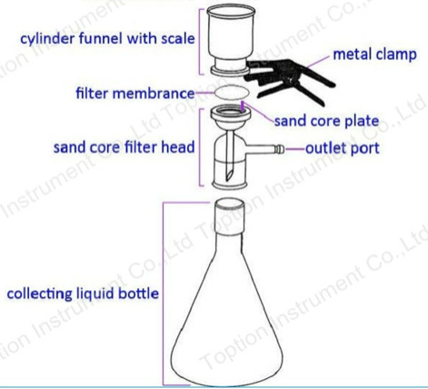
CATCH BASIN
Figure 1. PdSO₄ Reagent Filtration Set-up

